Slide 1


TELECOM CHURN PREDICTION
Infosys Springboard
Batch-2
Presented By Puneeth M

Slide 2
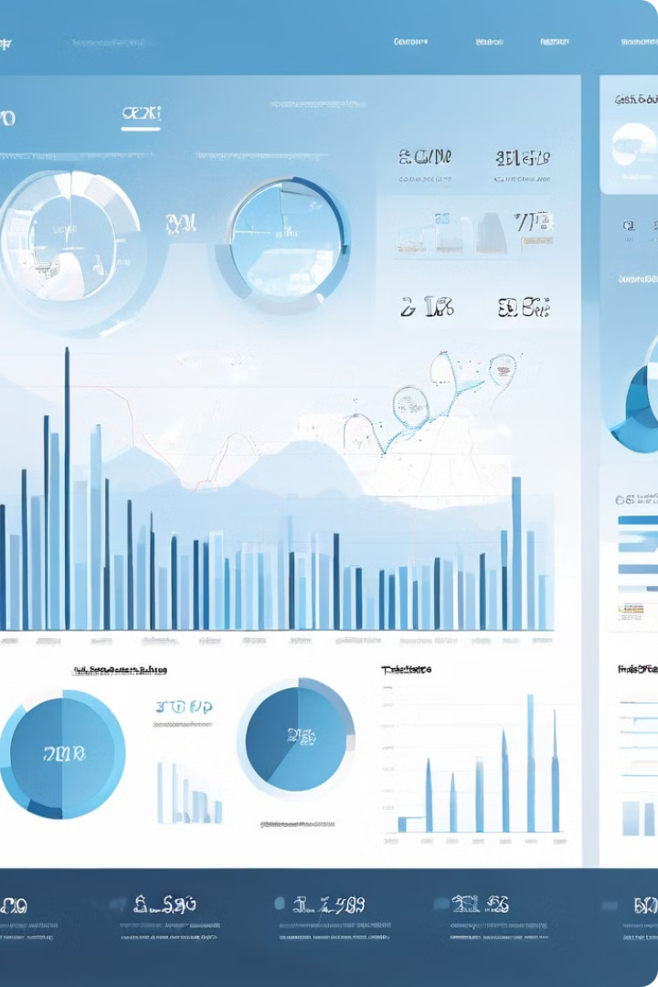
AGEND
About telecom churn prediction
Our Mission and Vision
Our Goals
Our Milestones
Challenges
Data Cleaning & Preprocessing
ML Model Building
Hyperparameter Tuning
Model Evaluation
Model Interpretation
Conclusion

Slide 3


About Telecom Churn Prediction
Telecom churn, the phenomenon of customers switching to a competitor's service, poses a significant challenge for telecommunications companies. Predicting and addressing churn is crucial, as it can have substantial financial and operational impacts on the industry. The purpose of this project is to develop a robust churn prediction model that will enable telecom providers to proactively identify and retain customers at risk of leaving, ultimately improving customer loyalty and the bottom line.

Slide 4

Our Mission and Vision
1
Mission Statement
2
Vision Statement
Our mission is to empower telecommunication companies with predictive analytics, enabling them to identify and retain customers at risk of churn, thereby improving customer satisfaction, reducing operational costs, and driving long-term business growth.
Our long-term vision is to become the industry standard in telecom churn prediction, revolutionizing the way telecommunications companies approach customer retention and loyalty. By leveraging advanced machine learning techniques, we aim to help our clients achieve sustainable competitive advantages and thrive in an increasingly competitive market.

Slide 5

Our Goals
Increase Customer Retention:
Reduce Revenue Loss:
Enhance Customer Satisfaction:
Minimize financial losses by preventing customer churn
Address customer issues proactively to improve overall satisfaction.
Identify at-risk customers and implement strategies to retain them.
This Photo by Unknown Author is licensed under CC BY-NC-ND

Slide 6

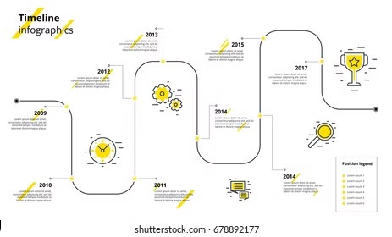
Our Milestones
1
Data gathering & understanding the dataset.
2
Data Collection & Preprocessing
3
Machine Learning Inodel building.
4
Hyperparaineter Tuning, SVM & Confusion Matrix

Slide 7
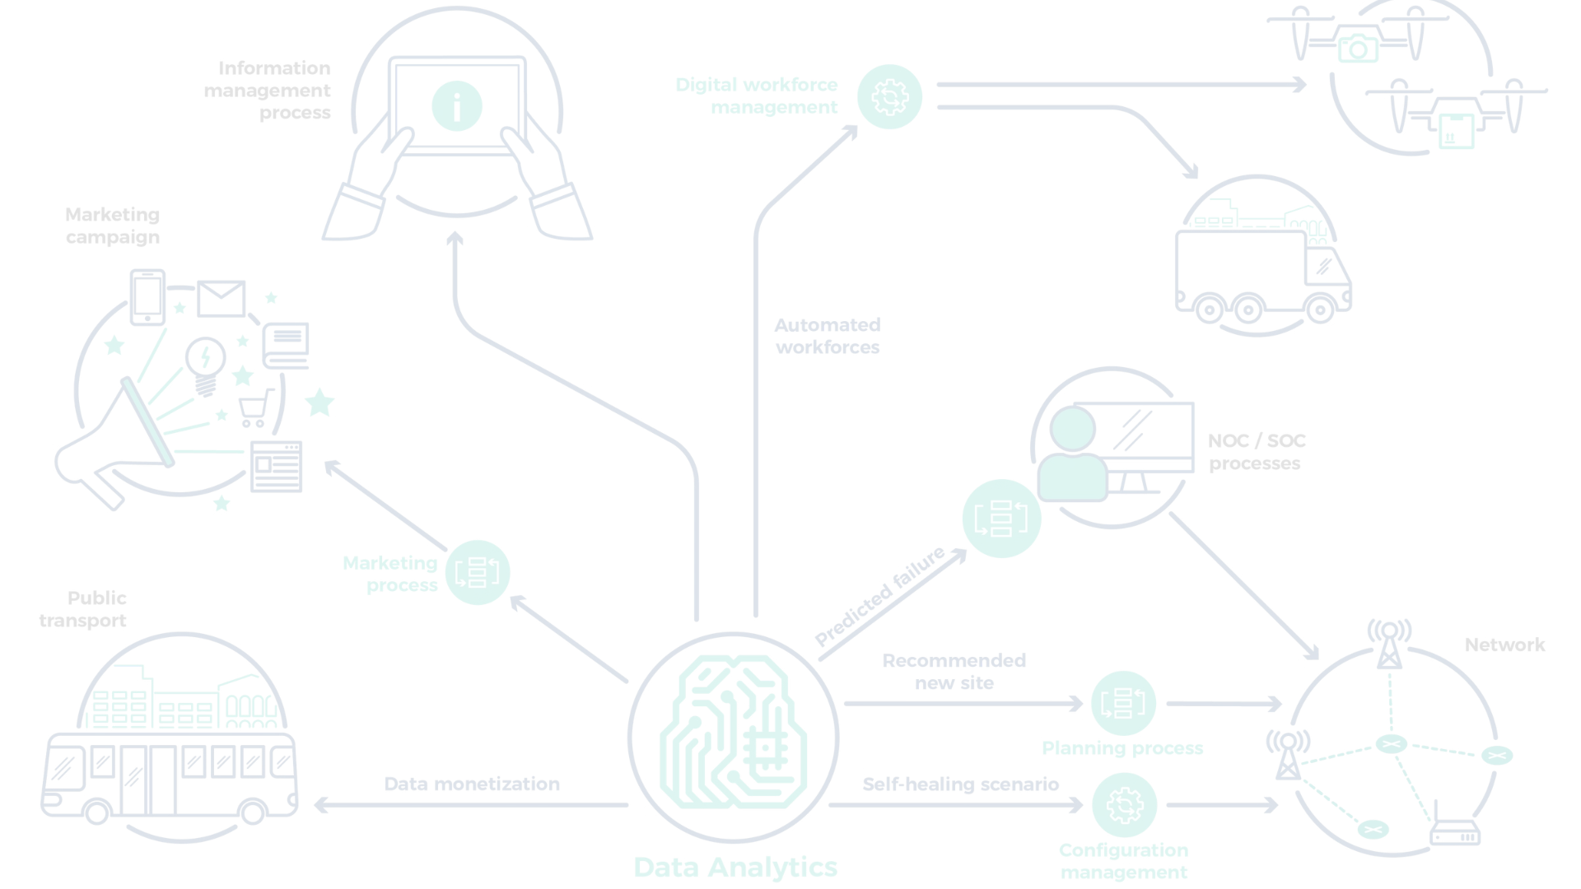
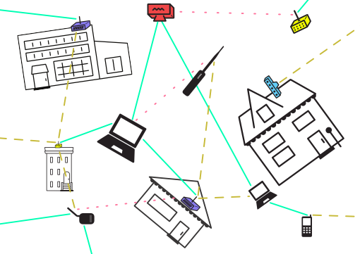
Challenges :
Data Quality and Integration: Telecom companies often have vast amounts of data stored across multiple systems, including customer demographics, call logs, usage patterns, and billing information. Integrating and cleansing this data for analysis can be challenging, and poor data quality can lead to inaccurate predictions
IInbalanced Data: Telecom datasets are often imbalanced, with a small percentage of customers churning compared to those who remain. Imbalanced data can bias predictive models and lead to inaccurate churn predictions
Dynainic Custoiner Behavior: Customer behavior and preferences evolve over time, making it challenging to build accurate predictive models that adapt to changing patterns and trends.
•Scalability: Telecom companies serve large customer bases, and churn prediction systems must be scalable to handle massive volumes of data and real-time predictions.
•Real-Tiine Prediction: Implementing real-time churn prediction systems that can provide timely interventions to prevent churn is challenging due to the need for fast data processing and decision-making.
This Photo by Unknown Author is licensed under CC BY-SA

Slide 8

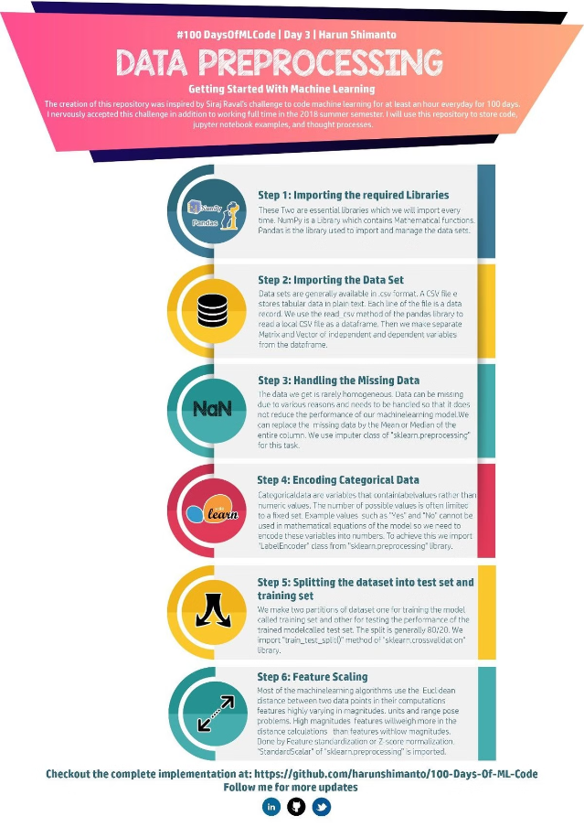
Data Cleaning & Preprocessing
Handling Misclassified Variables
Removing Duplicate Records Removing Unique Value
Variables
Removing Zero Variance Variables
Outlier Treatment
Missing Value Treatment
Removing Highly Correlated Variables
Multicollinearity(VIF>5)

Slide 9
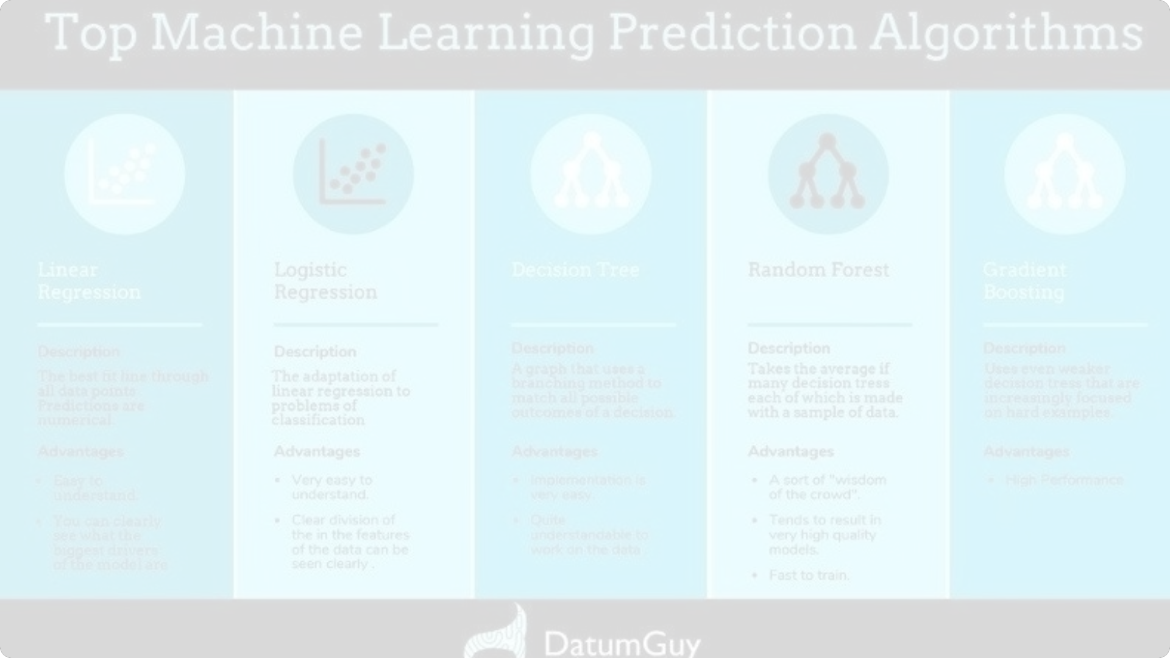
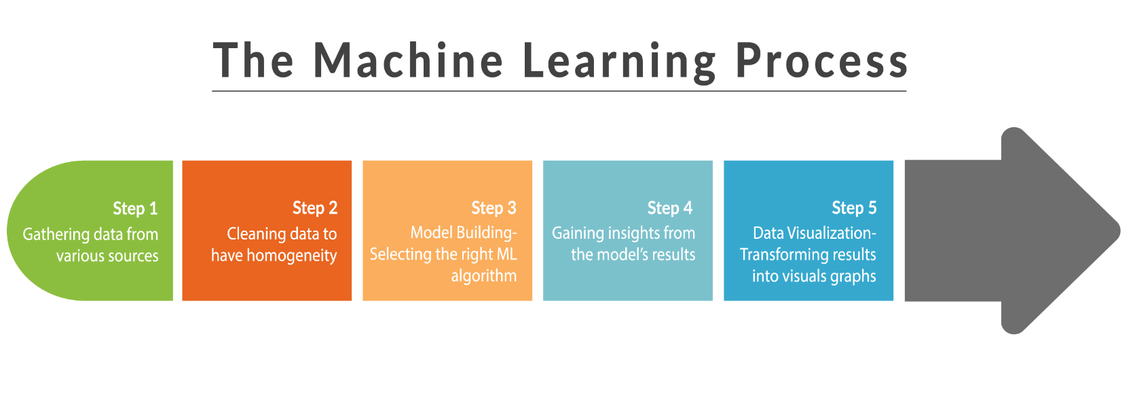
ML Model Building
►Logistic Regression
►Decision Tree
►Random Forest
This Photo by Unknown Author is licensed under CC BY-SA

Slide 10
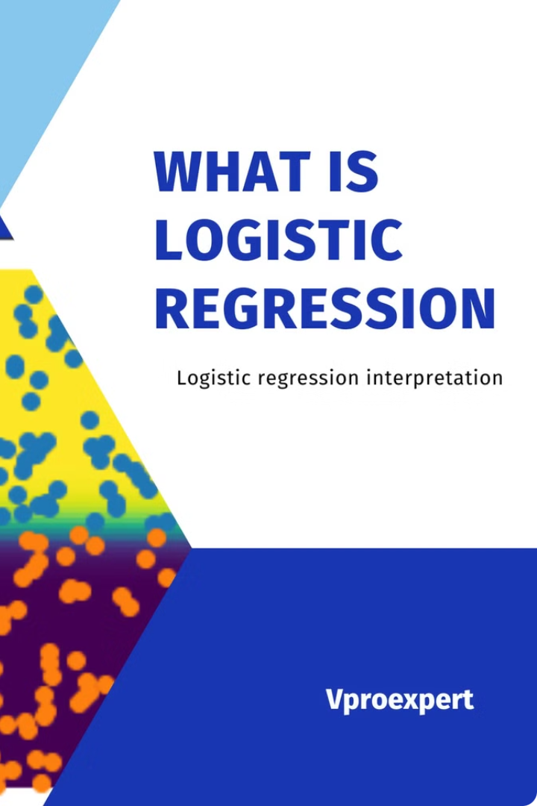
Logistic Regression
Logistic regression is a type of supervised ntachine learning algorithnt used for binary classification problents, where the target variable is a binary outconte (0 or 1). It's an extension of linear regression, but instead of predicting a continuous value, it predicts the probability of the binary outconte.
Logistic regression is crucial for predicting binary outcoines, offering interpretable results, probabilistic predictions, efficiency, and serving as a foundation for Inore coinplex Inodels.

Slide 11
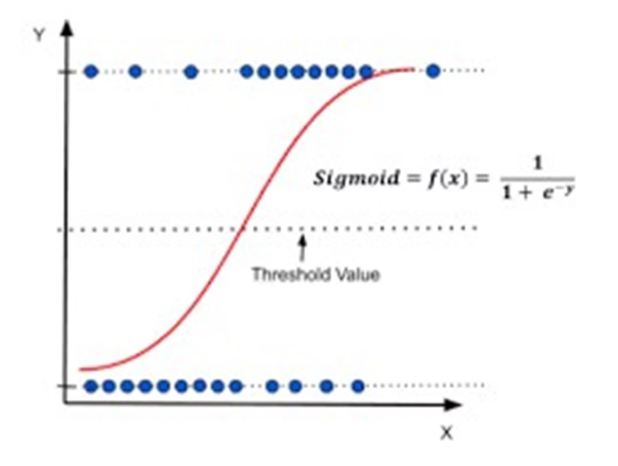
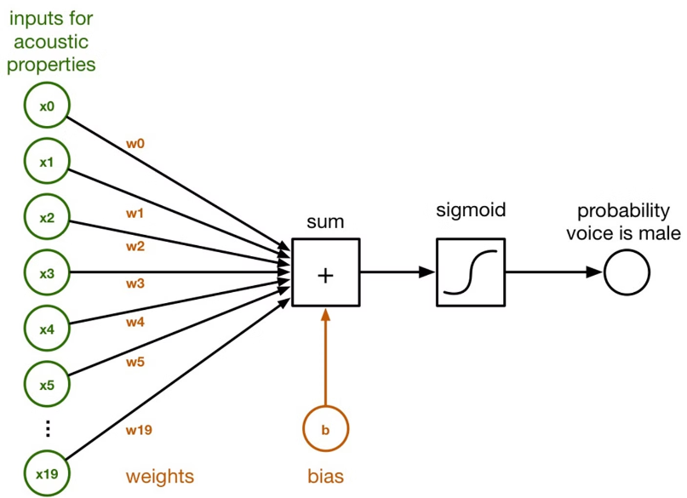
Pictures:

Slide 12
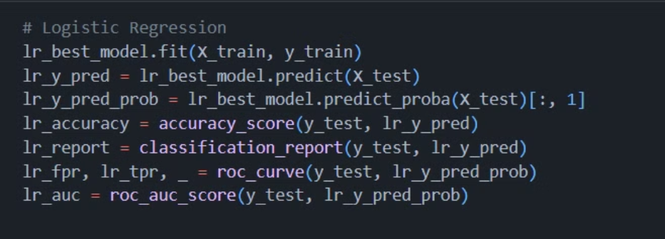
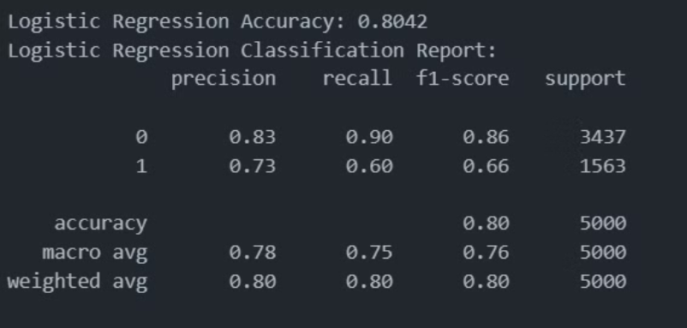
CODE SNIPPET

Slide 13
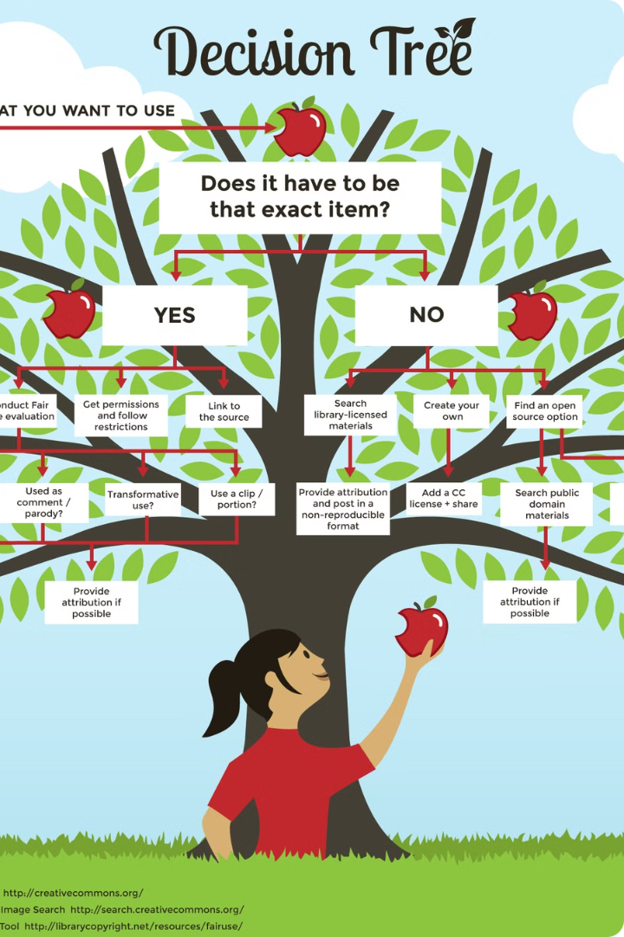
Decision Tree
Decision trees in 1nachine learning are a supervised learning algorith1n that enables developers to analyze the possible consequences of a decision and predict outco1nes for future data. A decision tree is a tree-like 1nodel that starts at the root and branches out to de1nonstrate various outco1nes.

Slide 14
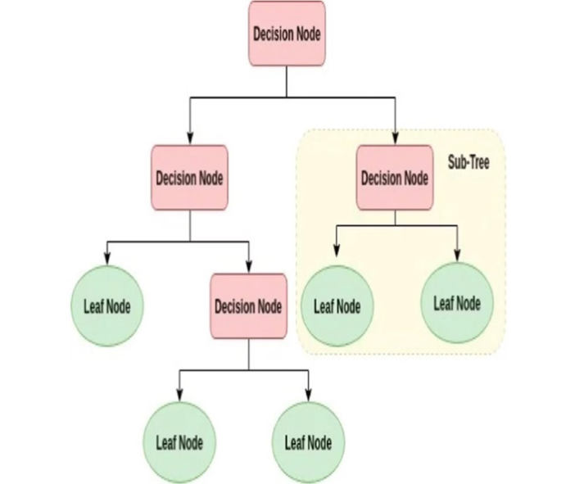
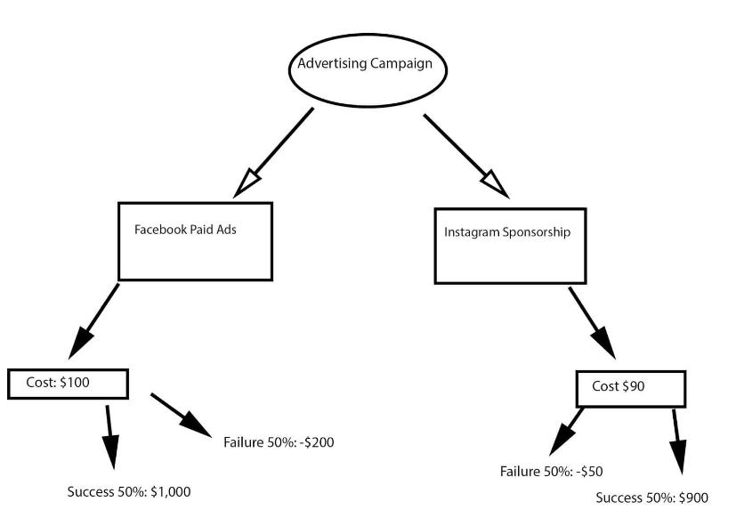
Pictures:

Slide 15
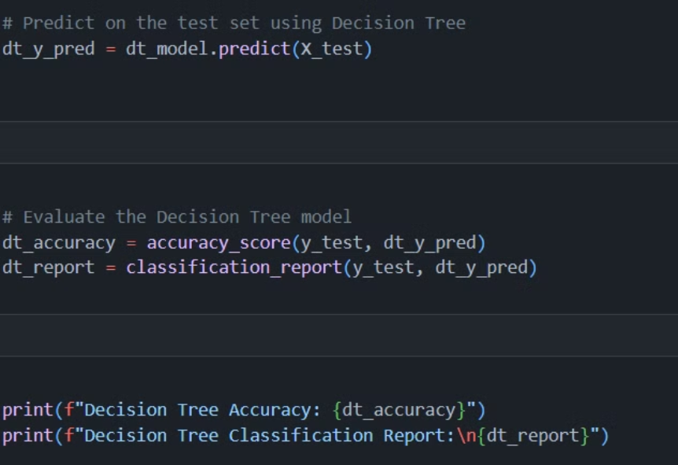
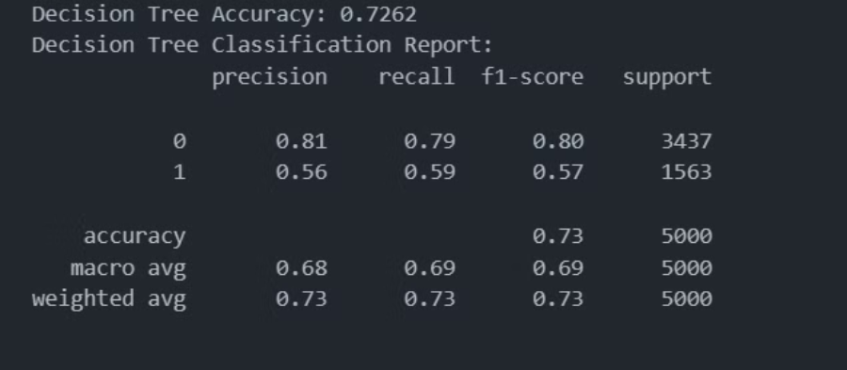
CODE SNIPPET:

Slide 16
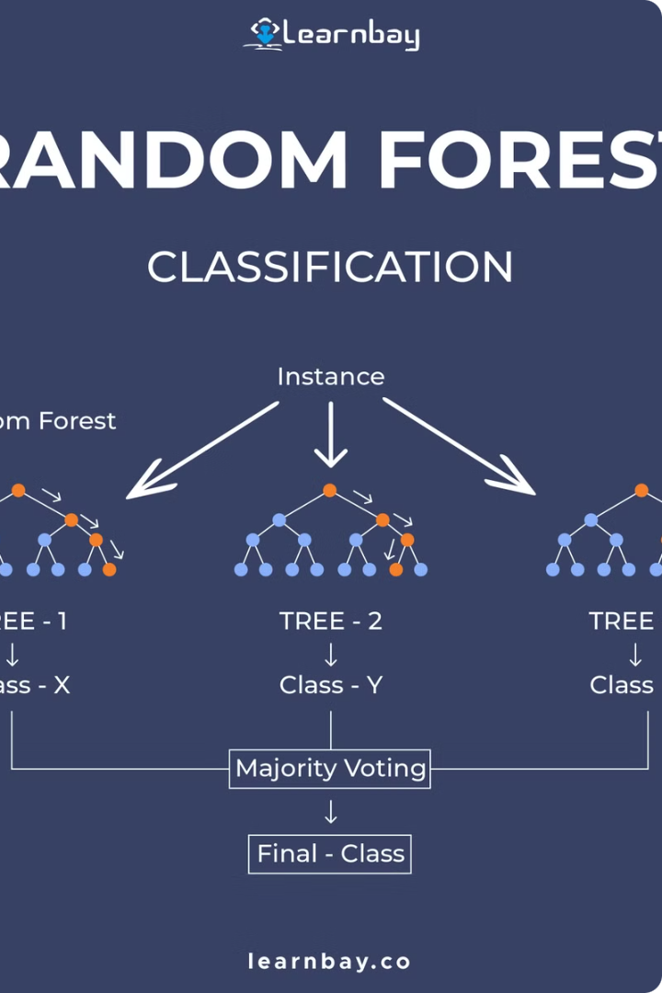
Random Forest
Randont Forest is a supervised learning algorithnt that contbines ntultiple decision trees to intprove the accuracy and robustness of predictions. It is a popular ensentble learning ntethod that is widely used in classification and regression tasks.

Slide 17
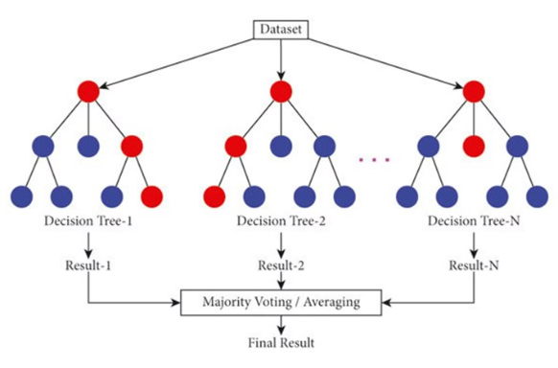
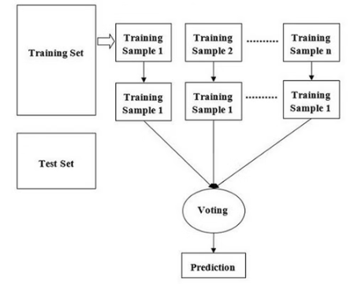
Picture:

Slide 18
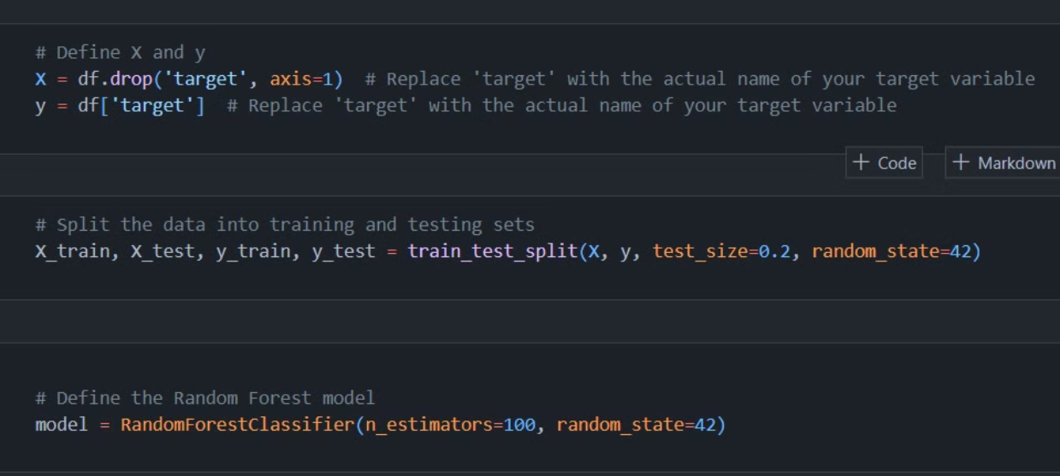
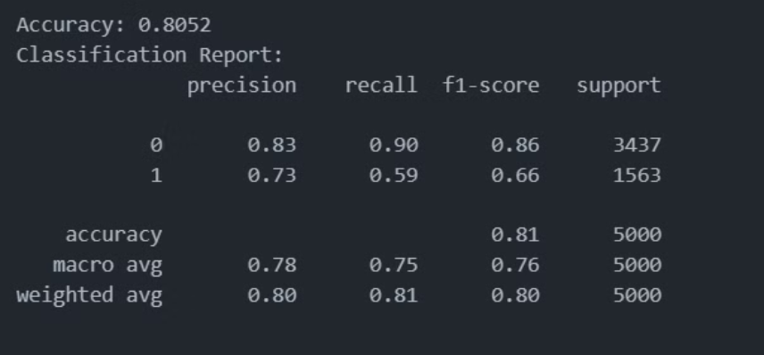
CODE SNIPPET:

Slide 19
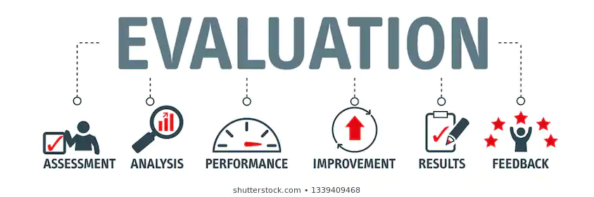
Model Evaluation
Models
Accuracy
Logistic Regression 80.4
Decision Tree 72.6
Random Forest 80.5

Slide 20
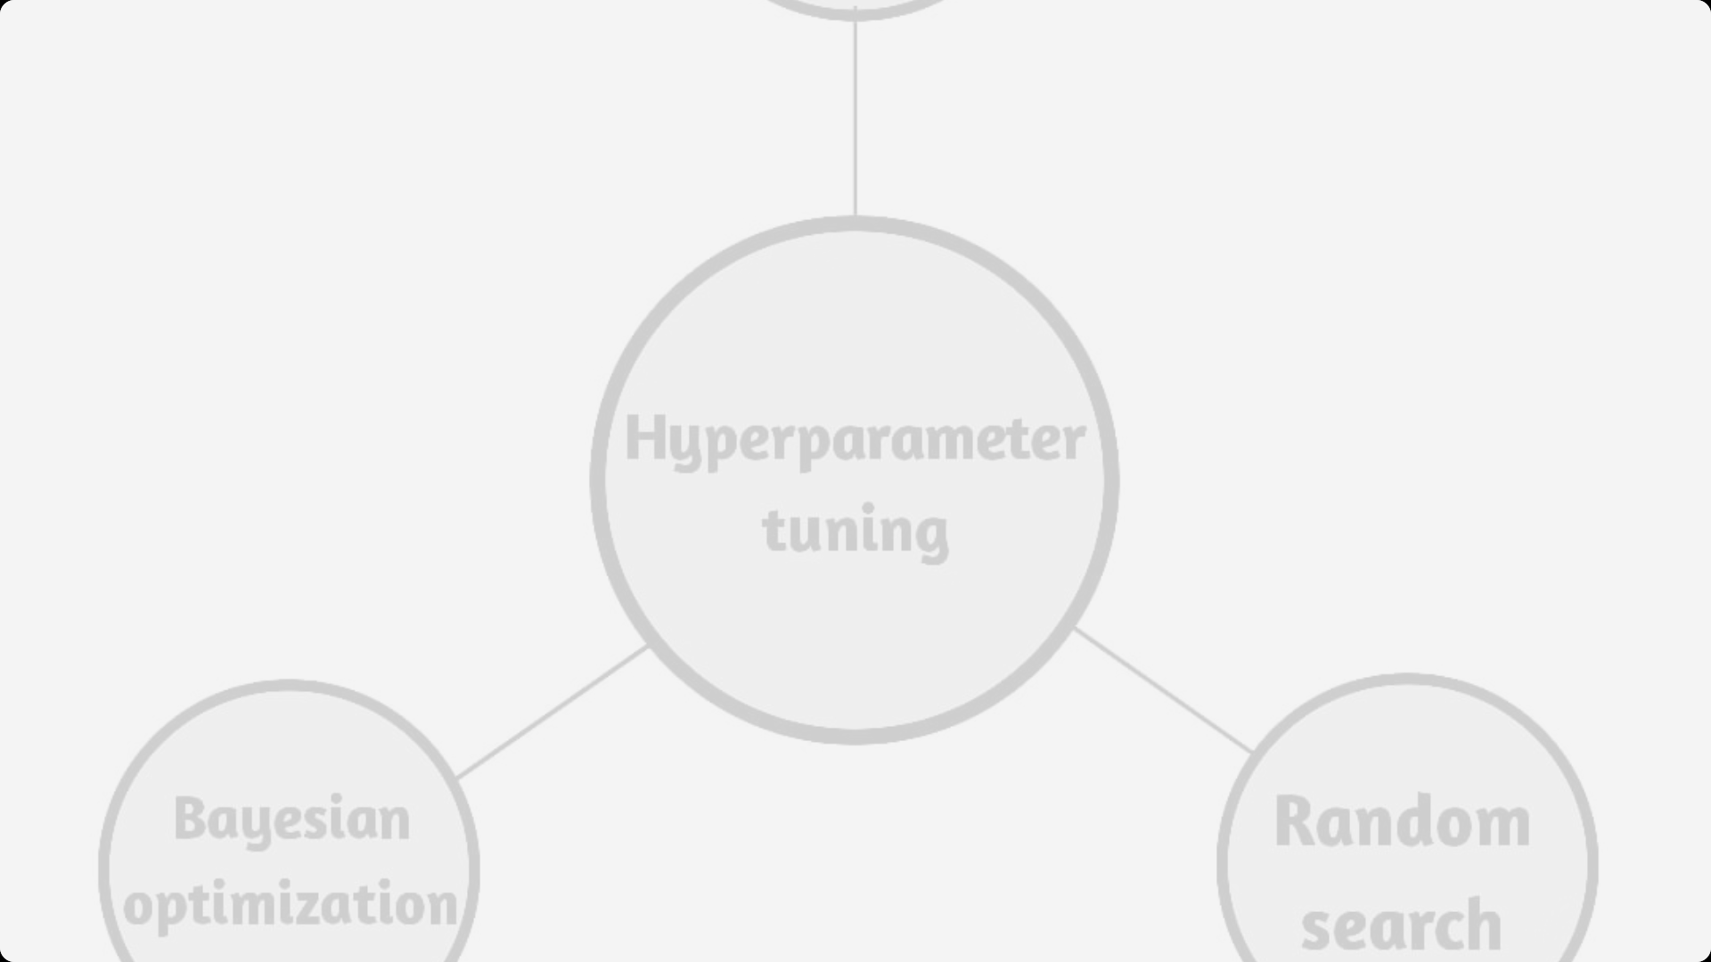


Hyperparameter Tuning
Hyperparameter Tuning
Hyperparameter Tuning is the process of finding the best settings for a machine learning model to improve its performance. This involves adjusting parameters that control the learning process, like the number of trees in a Random Forest or the learning rate in a neural network. By testing different combinations of these parameters, we identify the ones that yield the best results for our specific data.
Importance :
•Improves Model Performance: Proper tuning can significantly enhance the predictive accuracy and generalization of a model.
• Reduces Overfitting/Underfitting: Helps in finding the balance between bias and variance, ensuring the model performs well on unseen data.
OptimizesComputationalResources:Efficienttuningcanleadtofaster andmoreefficientmodeltraininganddeployment

Slide 21
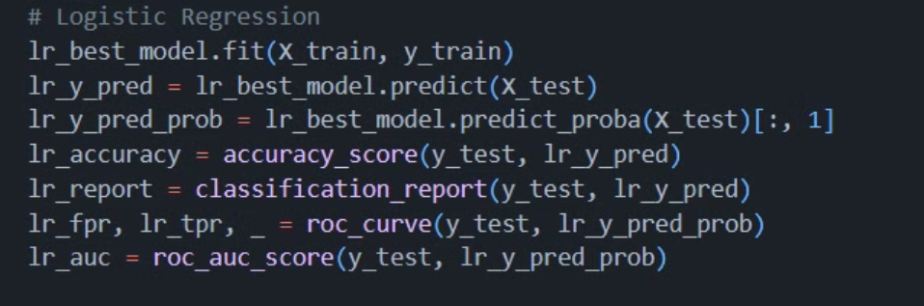
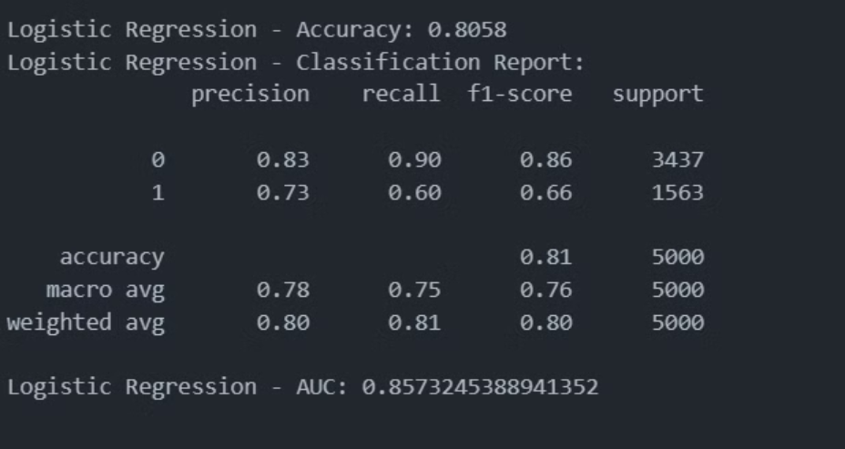
Hyperparameter Tuning LR:

Slide 22
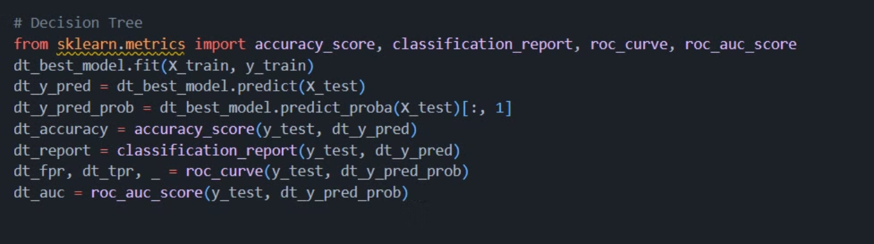
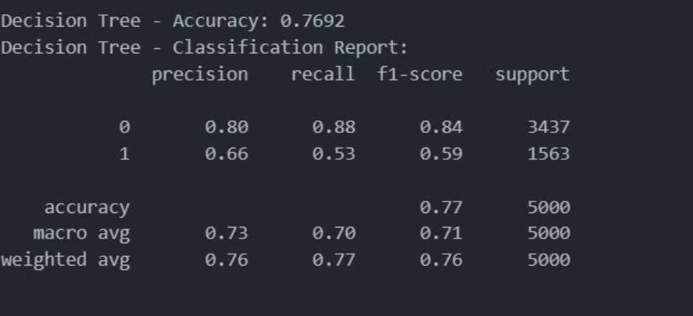
Hyperparameter Tuning DT:

Slide 23
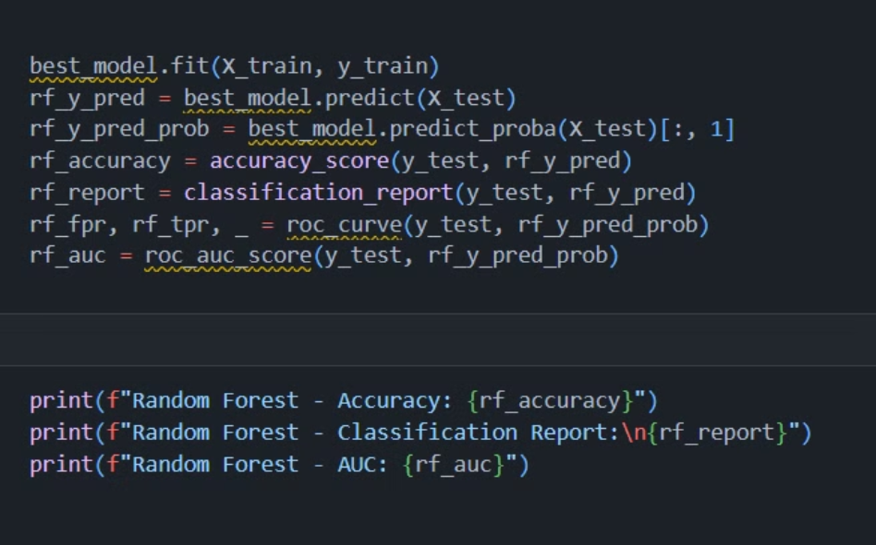
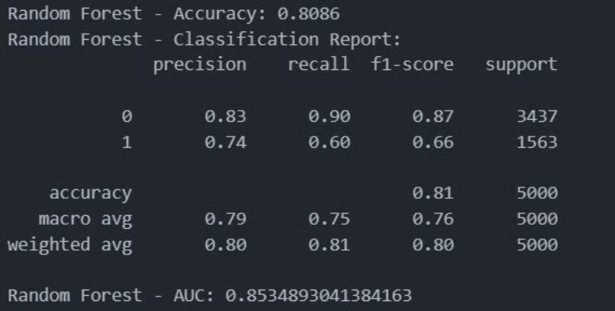
Hyperparameter Tuning RF:

Slide 24
Model Evaluation
Models
Accuracy
Logistic Regression 80.5
Decision Tree 76.9
Random Forest 80.6

Slide 25
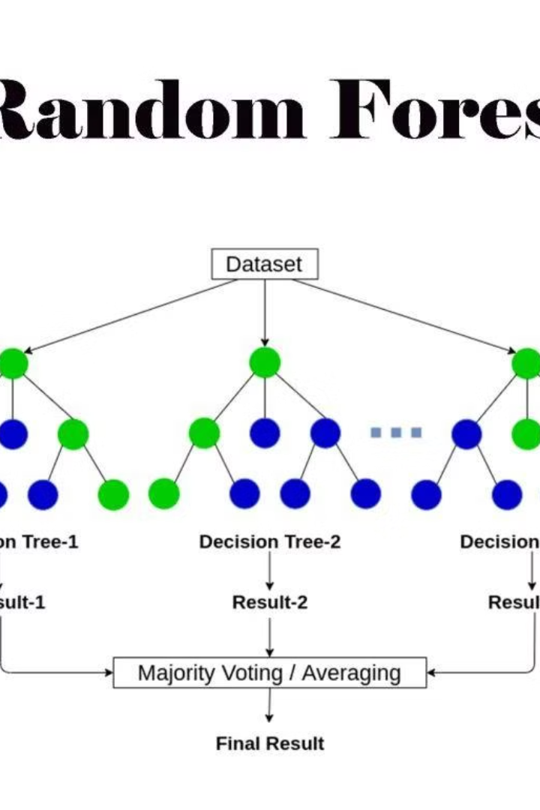
Why Random Forest?
RandomForests offer several advantages: they deliver high resist overfitting, highlight feature importance, and accuracy,effectively handle noise and missing values. Additionally, they are versatile and scalable, suitable for both classification and regression tasks. After evaluating all three models, we selected Random Forest due to its superior performance and minimal gap between training and testing accuracy.

Slide 26
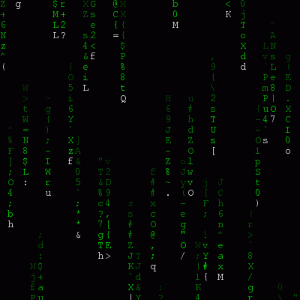
Confusion Matrix
What is Confusion Matrix ?
A confusion n1atrix is a table that evaluates a classification n1odel's perforn1ance by showing the counts of true positives, true negatives, false positives, and false negatives. It helps derive n1etrics like accuracy, precision, recall, and Fl score for a n1ore detailed perforn1ance assessn1ent
Components :
True Positives (TP): The number of instances correctly predicted as positive. :
True Negatives (TN): The number of instances correctly predicted as negative.
False Positives (FP): The number of instances incorrectly predicted as positive (Type I error).
•False Negatives (FN): The number of instances incorrectly predicted as negative (Type II error).

Slide 27
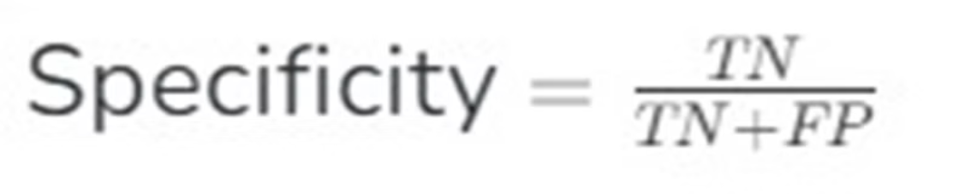
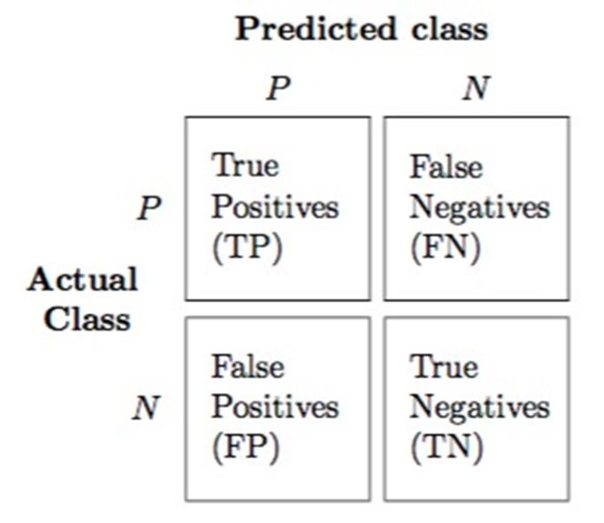
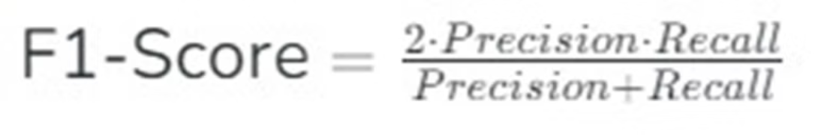
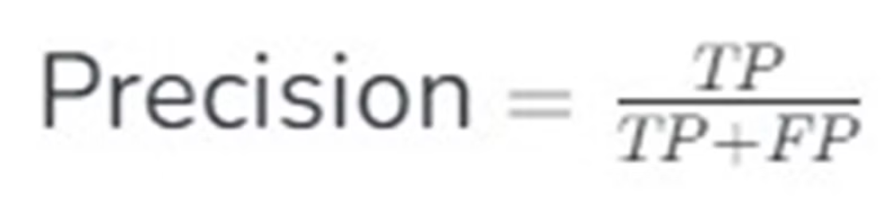
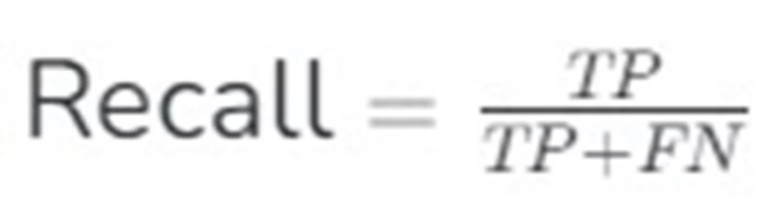
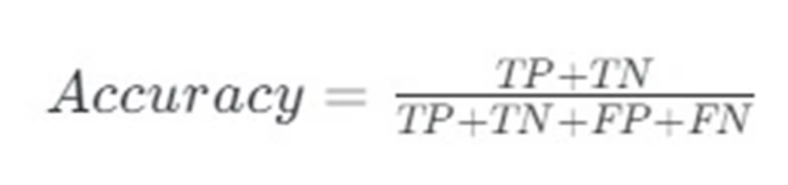
Formula :

Slide 28
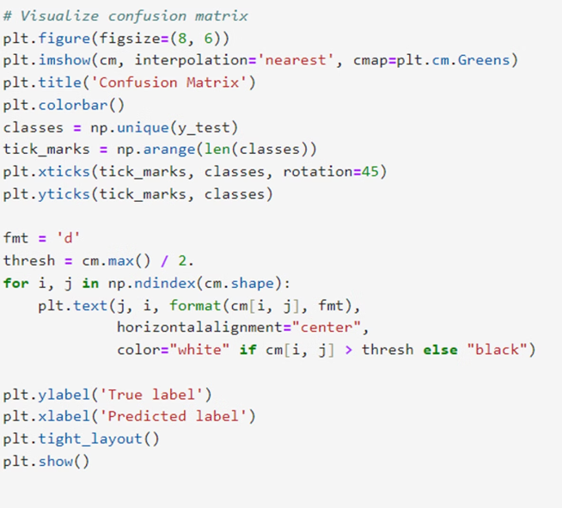
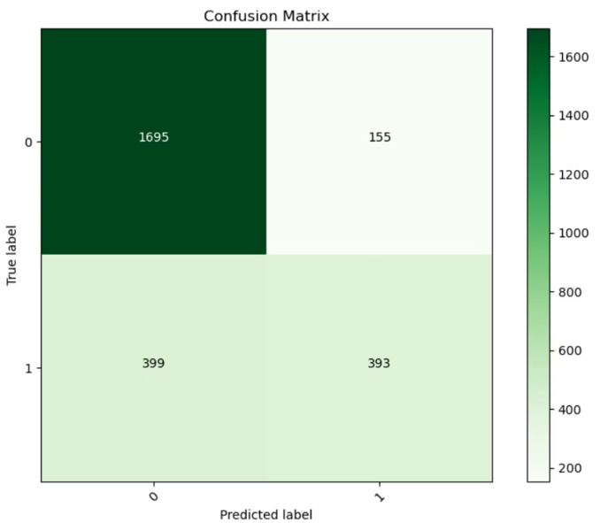
CODE SNIPPET LR:

Slide 29
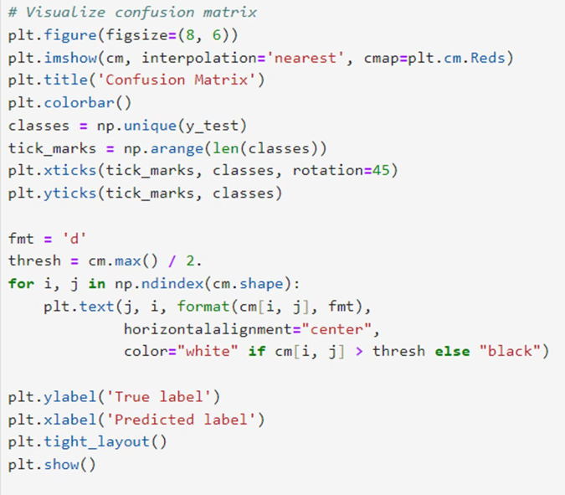
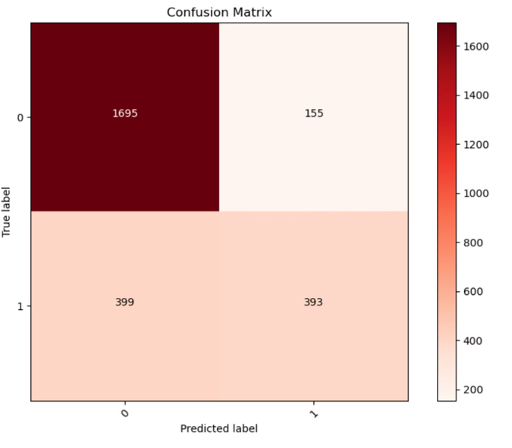
CODE SNIPPET RF:

Slide 30
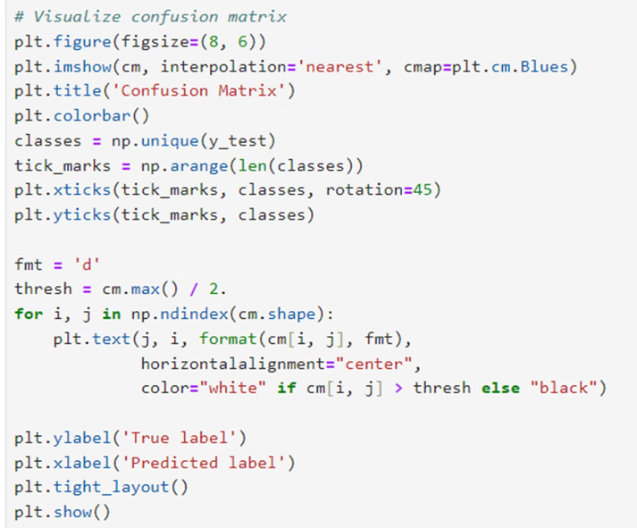
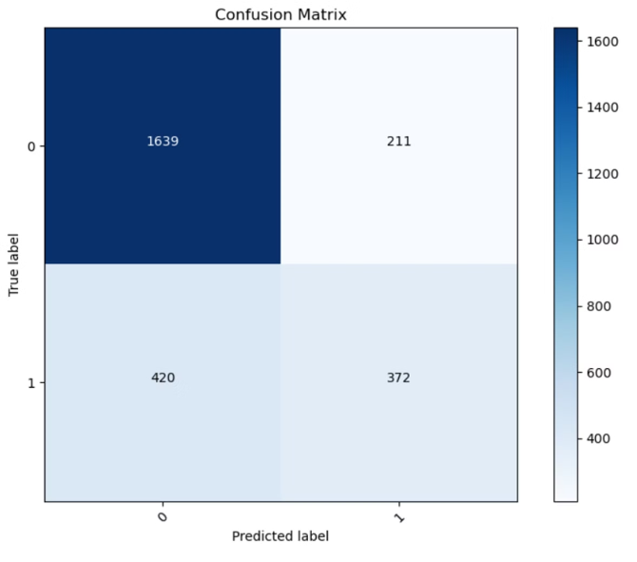
CODE SNIPPET DF:

Slide 31
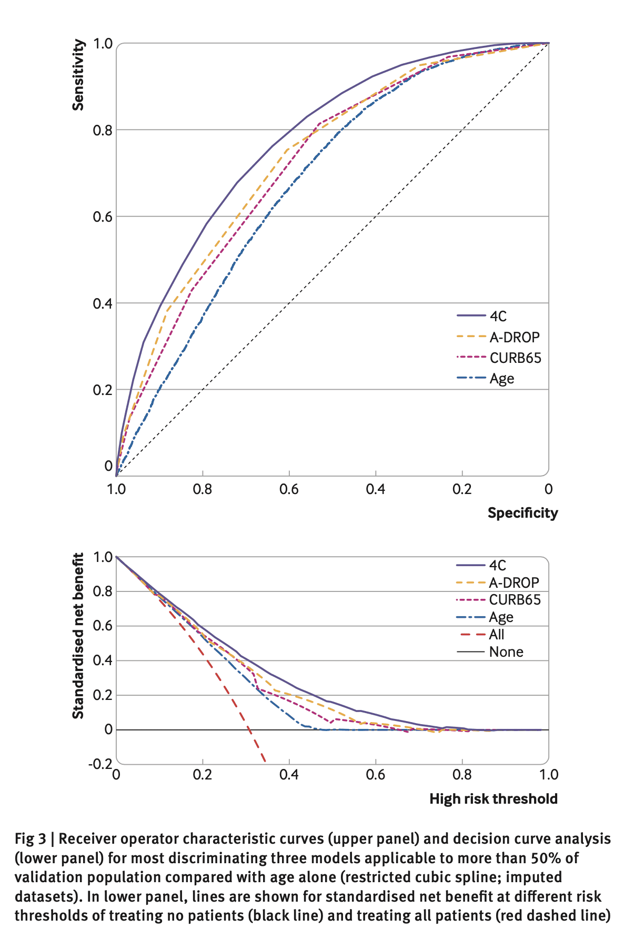
ROC CURVE
A receiver operating characteristic (ROC) curve is a graph that shows how well a classification model or diagnostic test performs at different classification thresholds. ROC curves are used in many fields, including medicine, radiology, machine learning, and natural hazards
Precision and Recall Curve
Precision refers to the confidence with which a positive class is predicted as positive, while recall measures how well the model identifies the number of positive class instances from the dataset. Note that the positive class is the class of interest

Slide 32
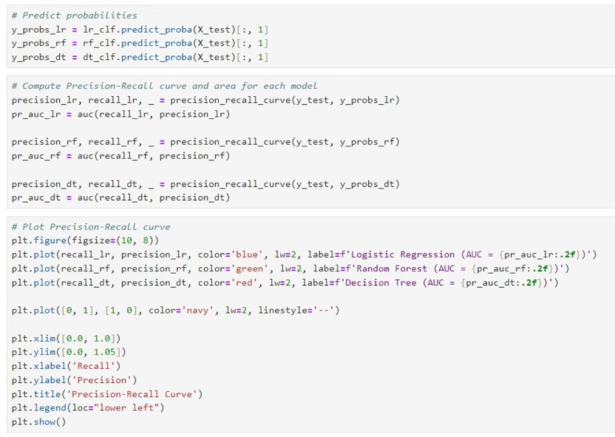
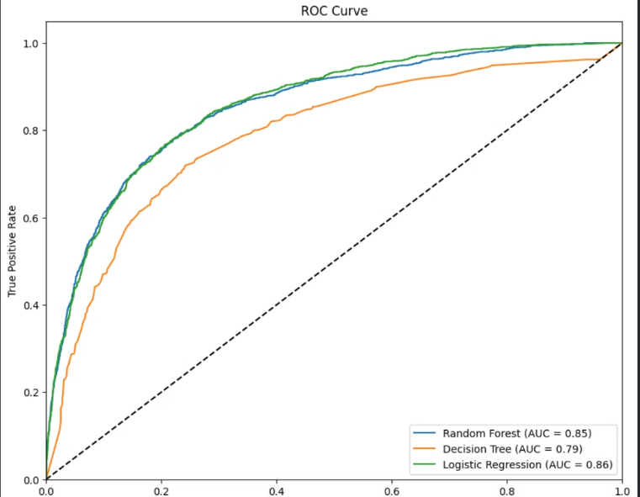
ROC CURVE MODELS:

Slide 33
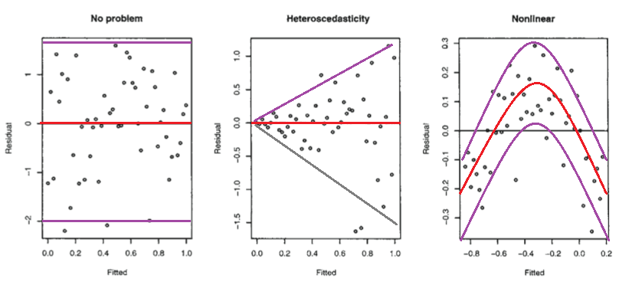
Model Interpretation
Importance of Interpretability
In the context of telecom churn prediction, model interpretability is crucial. By understanding the key factors driving churn, telecom companies can develop more effective retention strategies and tailor their customer engagement efforts to address the specific needs and concerns of their customers.
Techniques Used
To gain insights into the inner workings of our XGBoost model, we employed various interpretability techniques, such as feature importance analysis and SHAP (Shapley Additive Explanations) values. These methods allowed us to identify the most influential variables in predicting churn, as well as the specific impact of each feature on the model's output.
Key Insights
Our analysis revealed that factors such as customer tenure, monthly billing amount, and the number of customer service interactions were among the most significant predictors of churn. This knowledge will enable our clients to develop targeted retention campaigns, focusing on areas that are most likely to reduce churn and improve customer loyalty.

Slide 34
Conclusion:
• l1nproved Custo1ner Retention: By accurately predicting which customers are likely to churn, telecom companies can implement targeted strategies to retain valuable customers, ensuring their satisfaction and loyalty.
•Cost Reduction: Preventing churn is more cost-effective than acquiring new customers. Churn prediction allows for efficient resource allocation and reduces costs associated with customer attrition.
• Enhanced Custo1ner Experience: Understanding customer behavior and preferences enables telecom providers to offer personalized experiences, address concerns proactively, and significantly improve overall satisfaction.
• Increased Revenue: Retaining existing customers and maximizing their lifetime value leads to steady revenue streams and sustainable business growth.
•Co1npetitive Advantage: Effective churn prediction and management provide telecom companies with a competitive
edge through superior service, tailored offers, and proactive retention initiatives.

Slide 35
THANK YOU

